Slide 1
Phonetics & Phonology:
Do Vowels Matter?
Ԫ. M. Пӱрceлъ

Slide 2
WHAT ARE VOWELS IN OUR LANGUAGES
DIFFERENCE WRITTEN VERSUS SPOKEN LANGAUGE
“WE ALL SPEAK DIFFERENT VARIETIES OF THE SAME LANGUAGE”
LANGUAGE UNIVERSALS
SONORITY SEQUENCING
[Fnick, Ftick]
WHY IT DOES-/-DOESN’T MATTER
So what is sonority?
و, ا, ي,
A, E, I, O, U, Y,
ㅗ, ㅜ, ㅟ, ㅏ
basic linguistic and phonologic theory and consider how relevant it is in your own languages.

Slide 3
SONORITY & FUNCTION
VALUE
1-PLOSIVES
2- FRICATIVES
3 - NASALS
4- LIQUIDS
(don’t forget interactive L)
5-GLIDES
6-VOWELS
/ ðə kwɪk braʊn fɑks ʤʌmpt oʊvər ðə prɪˈzʌmpʧəwəs leɪzi dɔg /
(International Phonetic Association, 2015)

Slide 4
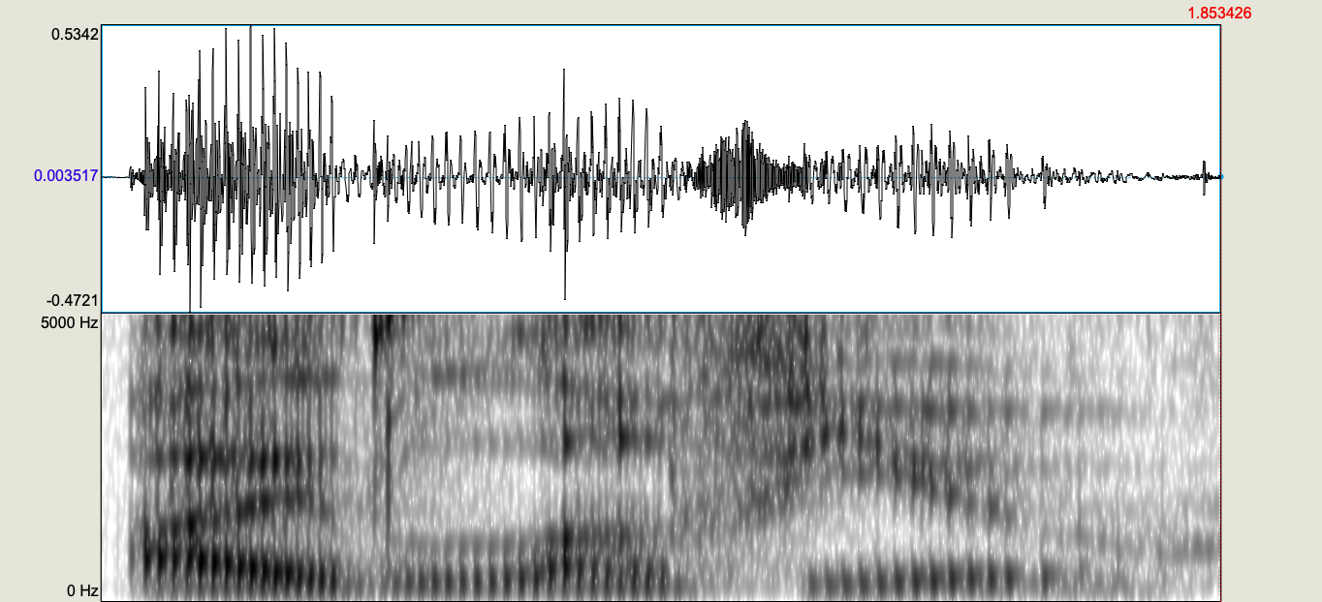
… VOWELS – Nucleus of the Syllable
/ k r a k /
/ K l i n /
/ p l I z /
/p l o t /
/ p r I s t i n /
/ p r I m/
CCVCC
1 3 6 41
(Hayes, B., 2015)
(Purcell J., 2018)

Slide 5
… BUT WHAT ARE VOWELS the THEORY
JUST PLACE HOLDERS BETWEEN SOUNDS // OR THE CORE TO SOUND HOLDERS
EPENTHETIC VOWEL
THE SCHWA
IF WE HAVE ALL OF THESE SOUNDS, WHAT DO WE CHOOSE TO USE?
(International Phonetic Association, 2015)

Slide 6
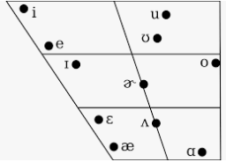
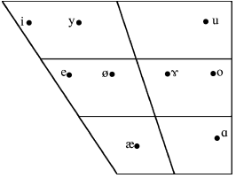
OBSERVE CONTRASTIVE VARIETIES
ENGLISH ESTONIAN
(International Phonetic Association, 2015)
(Asu, E. L., & Teras, P.,2009)

Slide 7
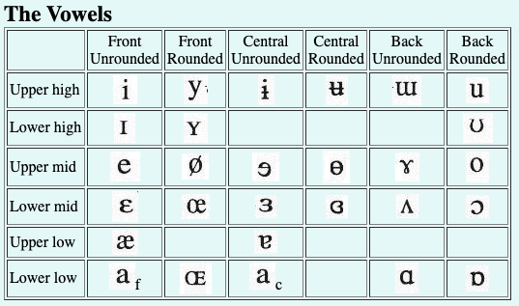
WHAT MATTERS HERE
CHARACTERISTICS
  FRONT?
  ROUND?
  HEIGHT
WHAT IS MISSING
  SCHWA?
(Hayes, B., 2015)
/ ðə kwɪk braʊn fɑks ʤʌmpt oʊvər ðə prɪˈzʌmpʧəwəs leɪzi dɔg /

Slide 8
Which word was it?
FNICK
          FTICK

Slide 9
BIBLIOGRAAFIA
Asu, E. L., & Teras, P. (2009). Estonian. Journal of the International Phonetic Association, 39(03), 367. https://doi.org/10.1017/S002510030999017X
Hayes, B. (2015) Linguistics 103 - Vowel Chart with Sound Files. Retrieved from https://linguistics.ucla.edu/people/hayes/103/Charts/VChart/
Prillop, K. (2013). Feet, Syllables, Moras and the Estonian Quantity System. Linguistica Uralica, 49(1), 1. https://doi.org/10.3176/lu.2013.1.01
Reetz H., Jongman, A. (2009) Phonetics: transcription, Production, Acoustics, and Perception. Wiley-Blackwell. Print.
Weinberger, S. (2019). personal interview, January 29, 2019

